Slide 1
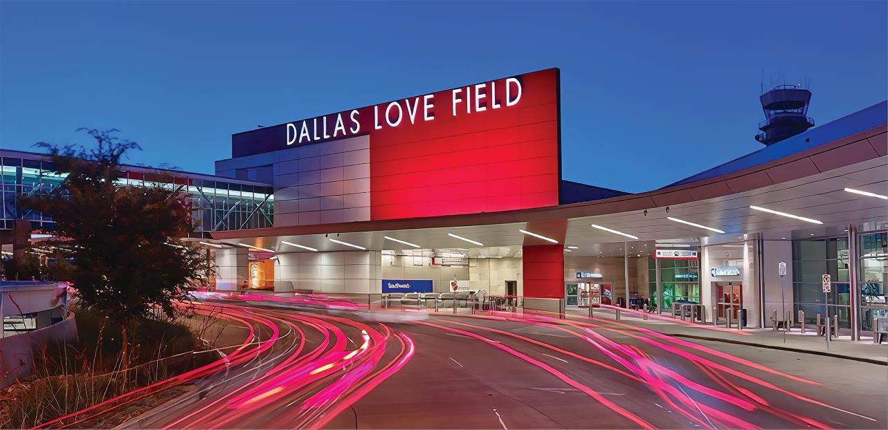
Love Field Environmental Advisory Committee Meeting
July 14th, 2022
Dallas Love Field
7555 Lemmon Ave

Slide 2

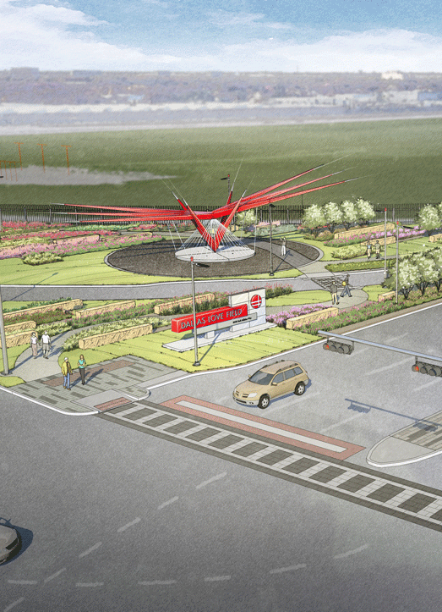
Agenda
Introductions
Voluntary Noise Program
  Noise Reports
Voluntary Noise Program Update
Runway 13R/31L Reconstruction
Airport Carbon Accreditation (ACA) Level 3
Open Discussion
Adjourn

Slide 3

Voluntary Noise
Program

Slide 4
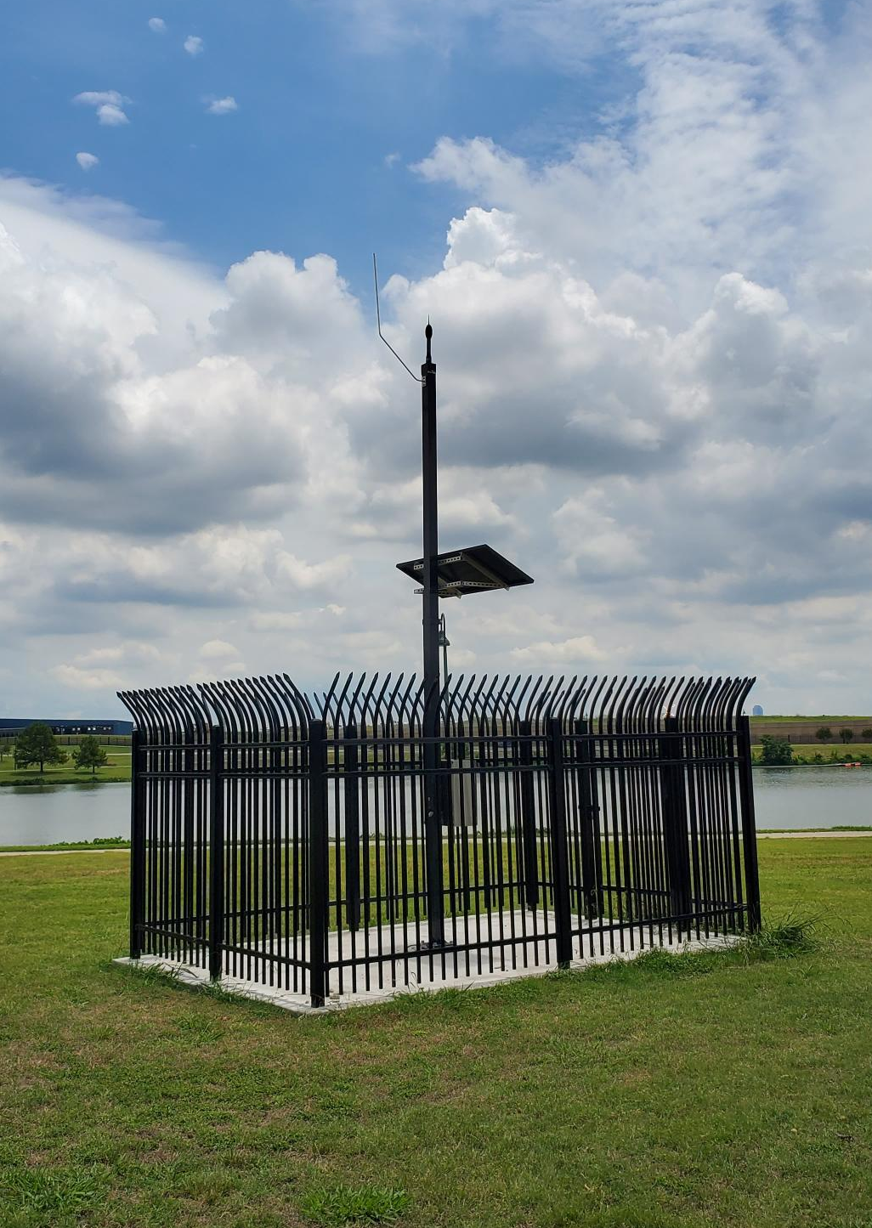
Dallas Love Field’s Voluntary Noise Program
To better respond to the concern of our neighbors, the City of Dallas’ Department of Aviation has developed a Voluntary Noise Program.
DOA serves as a liaison between the community and FAA while also disseminating noise information to stakeholders through outreach.
The Federal Aviation Administration manages all aspects of the National Airspace System in the United States.
FAA’s Air Traffic Control directs commercial air traffic to and from DAL Airport.
DAL’s Noise and Operations Monitoring System (NOMS) utilizes Casper Airport Solutions to monitor and understand aircraft.
Notes:
Casper airport solution is an advance NOM system that City of Dallas is utilizing
The system is comprised of 4 fixed noise monitors in the community.

Slide 5
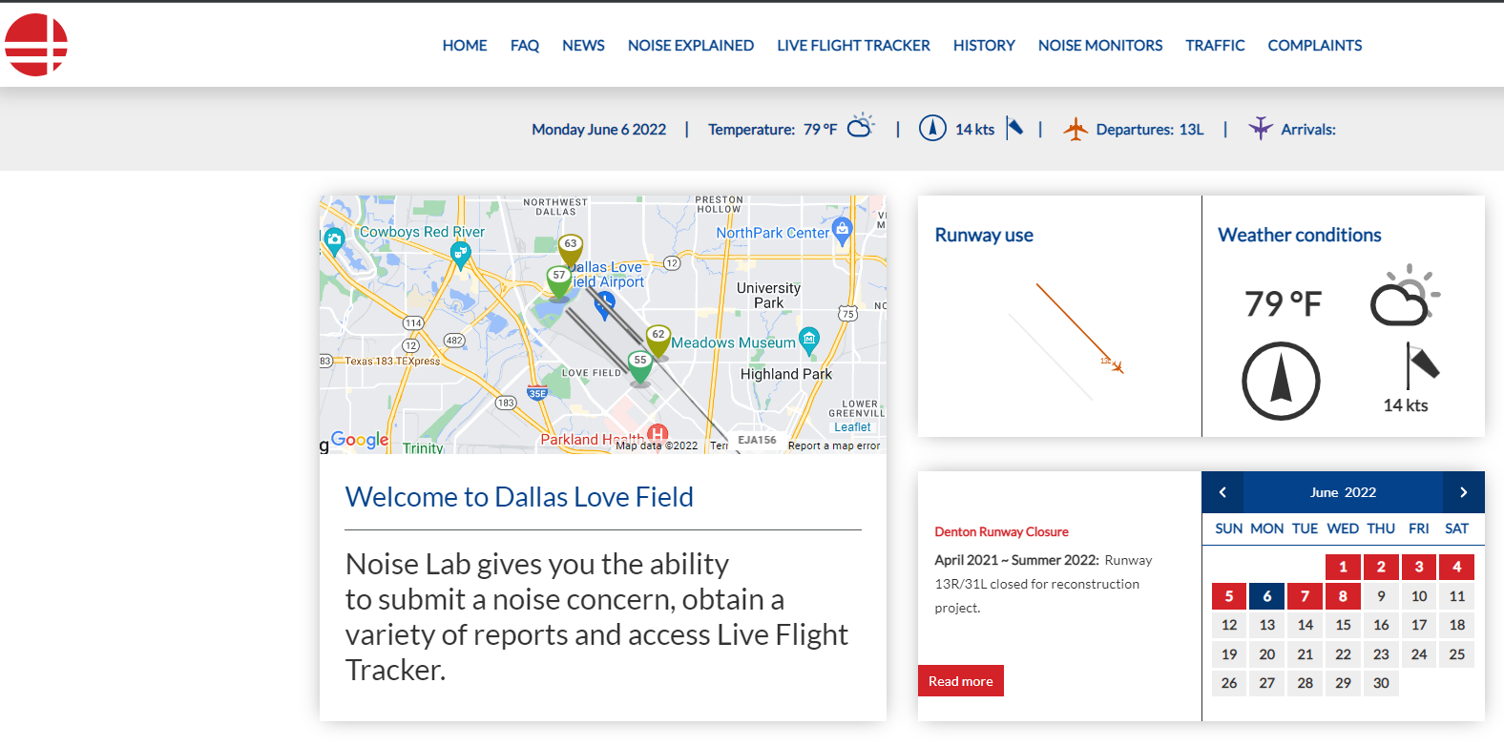
NoiseLab
Casper NoiseLab is an interactive public website that provides current information on aircraft noise, runway closures, outreach efforts and other useful information. It also displays statistical flights/noise information using both maps and charts.
https://dal.noiselab.casper.aero/

Slide 6
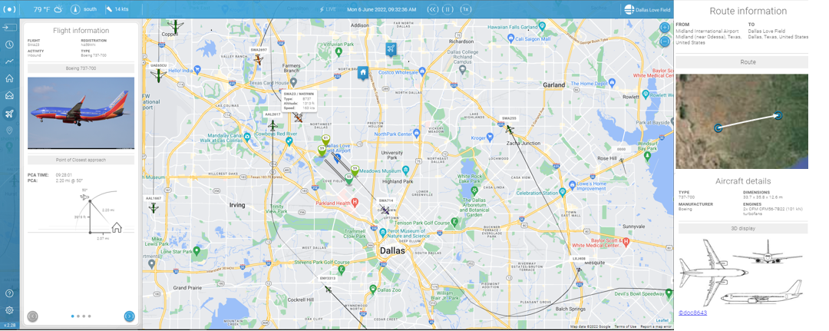
Flight Tracker
Dallas Love Field Airport has invested in an online tracking system for the movement of flights within the DFW Metroplex. Flight Tracker allows concerned individuals to research data on flights. The system simplifies the submission of noise complaints by offering an easy, online option for residents to register noise concerns.
https://flighttracker.casper.aero/dal/
Notes:
The public can view flights to and from Dallas Love Field Airport, Dallas Executive Airport as well as any transitional air traffic through the region
The public can link specific flights to their noise complaints, that in turn provide accurate information to the noise specialist.

Slide 7
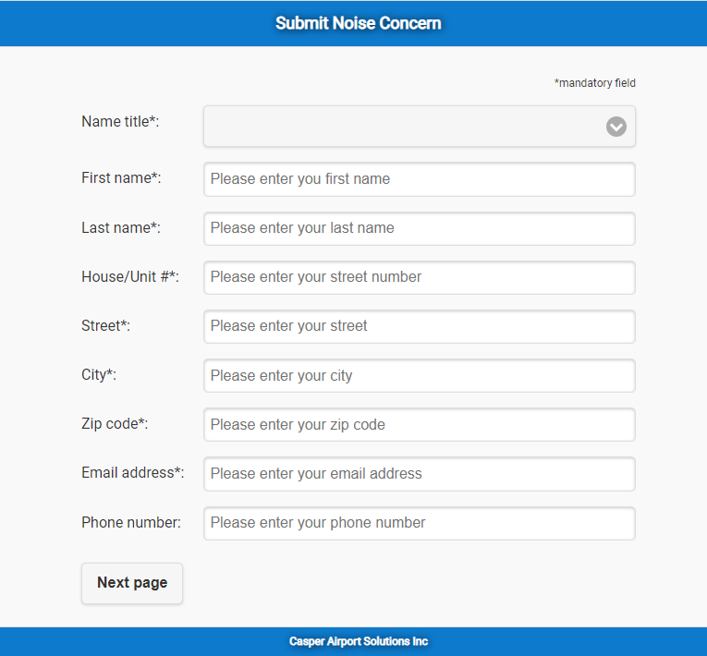
Submitting a Noise Complaint
All noise complaints are logged and reviewed daily by utilizing a Noise and Operations Monitoring System (NOMS) powered by Casper. DOA seeks to provide as much information as possible when investigating and responding to noise complaints.
Guidelines and Standards
Noise complaints will only be logged when they contain accurate and complete information, including the first and last name, physical address, date and time of the noise occurrence and means of contact (telephone number or email address) if feedback is requested.
It is recommended that noise complaints should be reported within one week of the occurrence.
The FAA’s Aviation Noise Ombudsman serves as a public liaison for issues about aircraft noise questions and complaints.
  Email : 9-asw-noise@faa.gov

Slide 8
Operation Statistics ( Apr – June 2022 )
Definitions
Air Carrier – A commercial carrier utilizing aircraft as its means of transport; an airline, as for passengers or freight.
General Aviation – All civil aviation operations other than scheduled air services and non‐scheduled air transport operations
for compensation or hire.
Other – Medical and Military flights
Source: Casper Airport Solutions Inc.

Slide 9
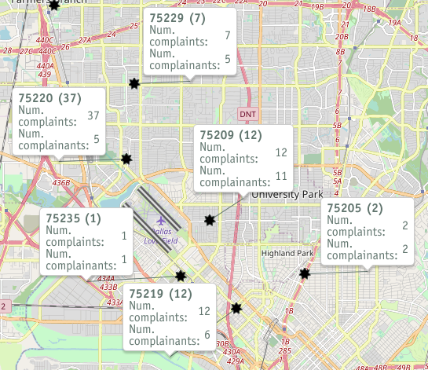
Noise Complaints ( Apr – Jun 2022 )
*Disclaimer: The map only displays zip codes
in the immediate Dallas Love Field area
Source: Casper Airport Solutions Inc.

Slide 10
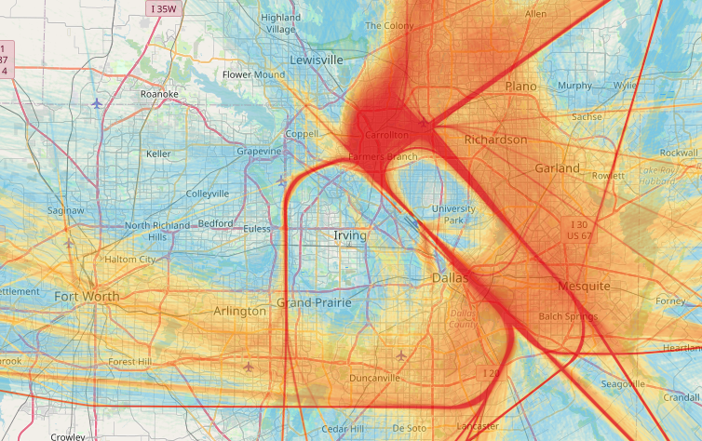
Radar Track
Density Map
( Apr – June 2022)
This is a graphical depiction for the frequency of aircrafts’ flight tracks over a defined area during the specified time period. This is an effective tool to illustrate arrival and departure routes.
Source: Casper Airport Solutions Inc.
Notes:
The following map takes all the flight track data for the given time period and creates the radar density map
Dark red in the middle of the picture shows the highest density of flight tracks over the runways.
The colors gradually move out to blue as the least dense.

Slide 11
Voluntary Noise Program Update

Slide 12
Noise Stakeholders
April 13, 2022, DOA briefed the City of Dallas’ Environmental Commission
May 2, 2022, DOA briefed the Environment & Sustainability Council Committee
As an outcome, DOA will host stakeholder meetings to review the Voluntary Noise Program (VNP) by discussing DAL’s current program and provide feasible noise measures to the FAA for their review and implementation.
  Venue for the City of Dallas to engage with the communities of Dallas Love Field Airport.
  Aims to provide information, the opportunity to review the existing program, and suggest new/modified noise mitigating measures.
  In addition to residents, airport tenants, and schools ; subject matter experts will also be present for their perspective and to discuss any potential impacts.

Slide 13
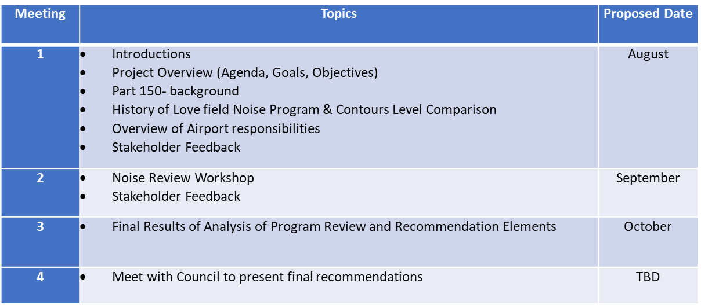
Objectives and Timeline
Review the current Noise Program and make recommendations to update:
  Sunsetting outdated measures
  Updating existing/outdated measures
  Proposing new feasible measures to be reviewed by Federal Aviation Administration (FAA)

Slide 14
Runway 13R-31L/ Taxiway C Phase 1 Reconstruction

Slide 15
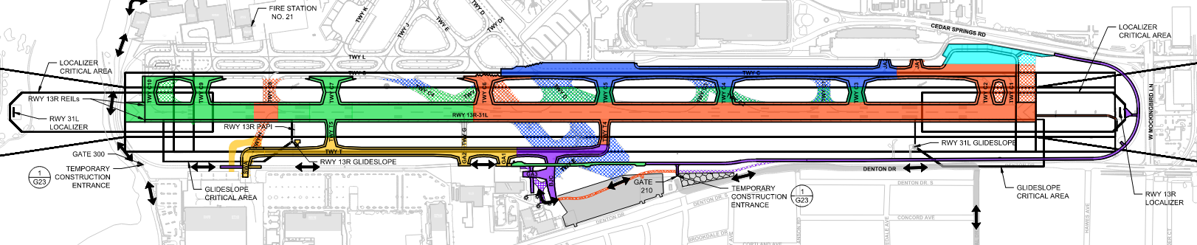
Phase | Duration | 3/21 | 4/21 | 5/21 | 6/21 | 7/21 | 8/21 | 9/21 | 10/21 | 11/21 | 12/21 | 1/22 | 2/22 | 3/22 | 4/22 | 5/22 | 6/22 | 7/22 | 8/22 | 9/22 | 10/22
1
*RWY Shutdown
*2
*3
4
5
Overall Project 82%
Phase-1 is at 100%
Phase-2 & 3 is at 100%
Phase 4 is at 85%
Phase 5 is at 10%

Slide 16
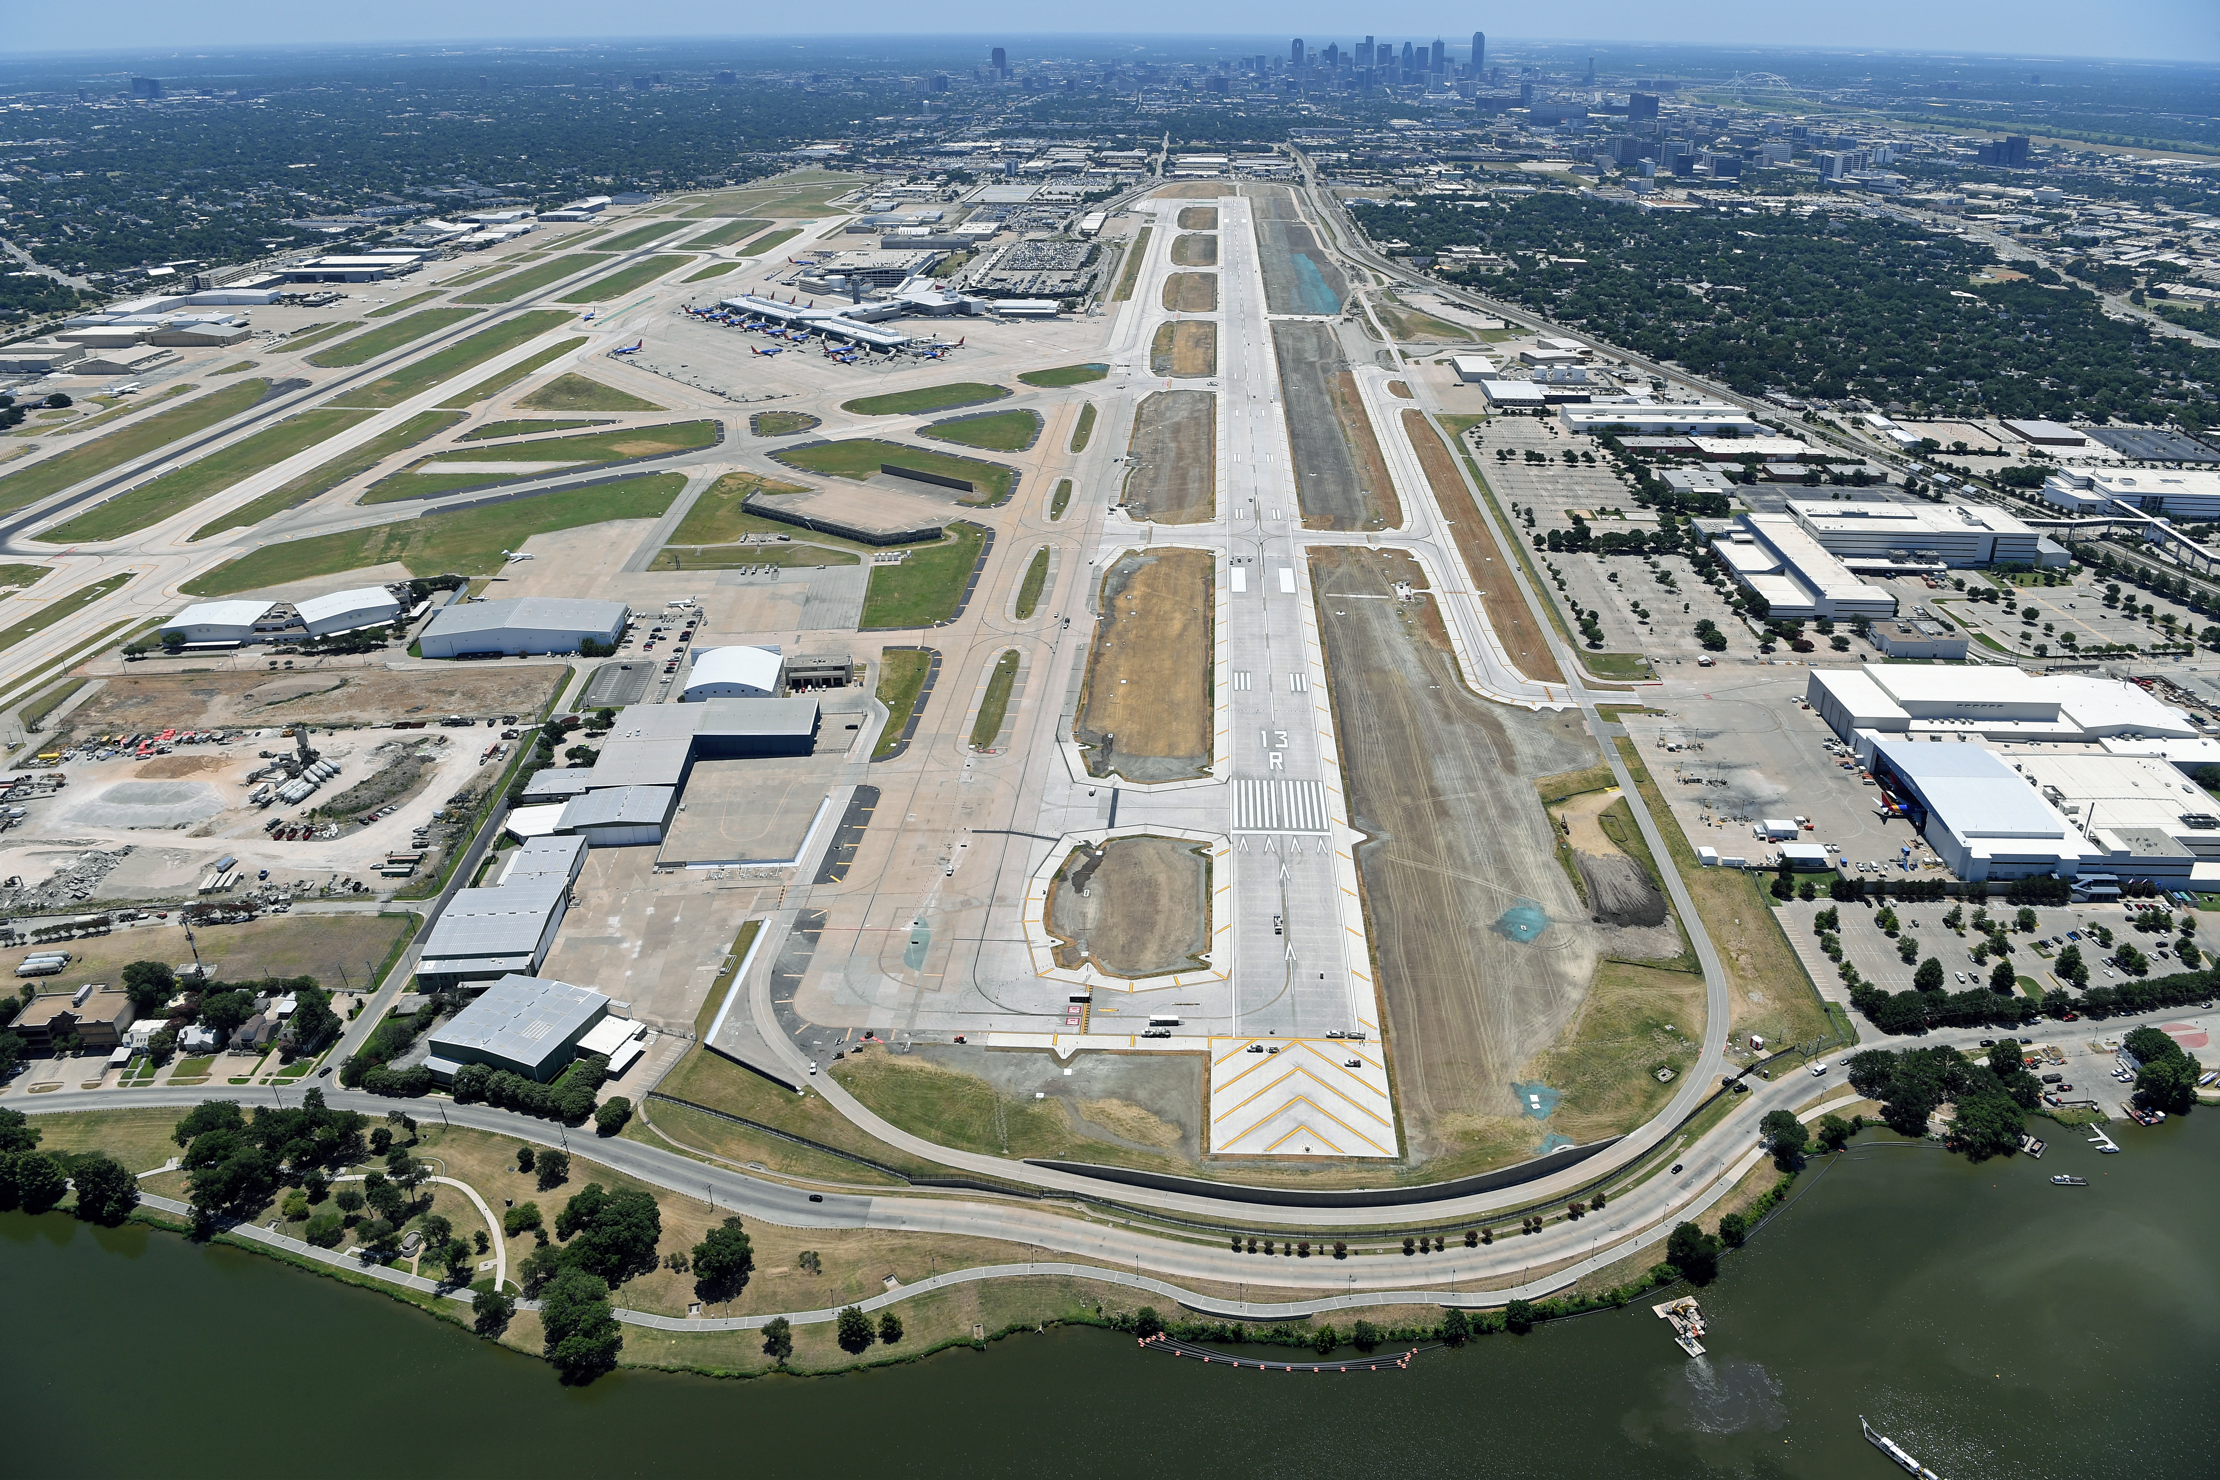
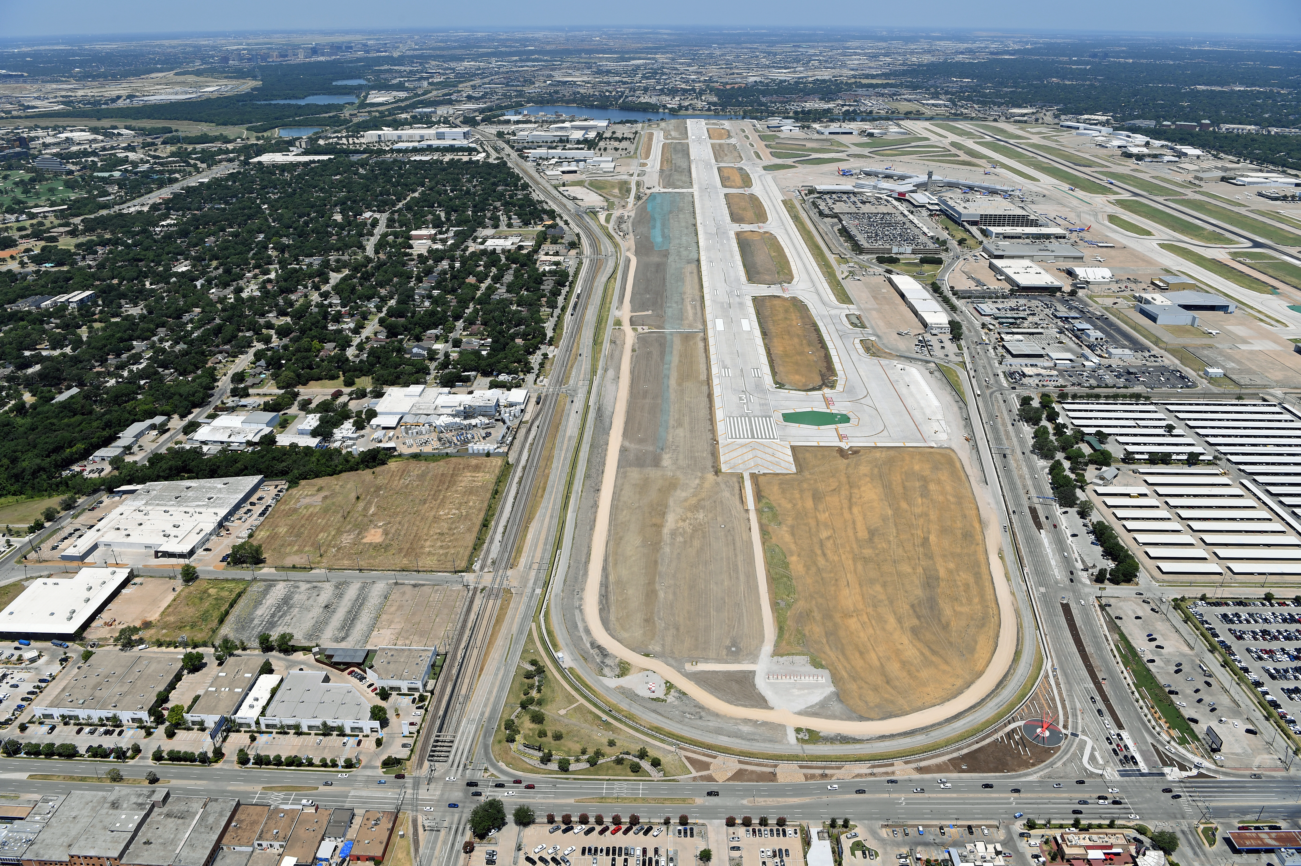
Runway 13R-31L Reconstruction
Figure 1 - RWY 13R looking SE
Figure 2 - RWY 13R/31L and TWY C SE
Notes:
Some photos from the air of the construction

Slide 17
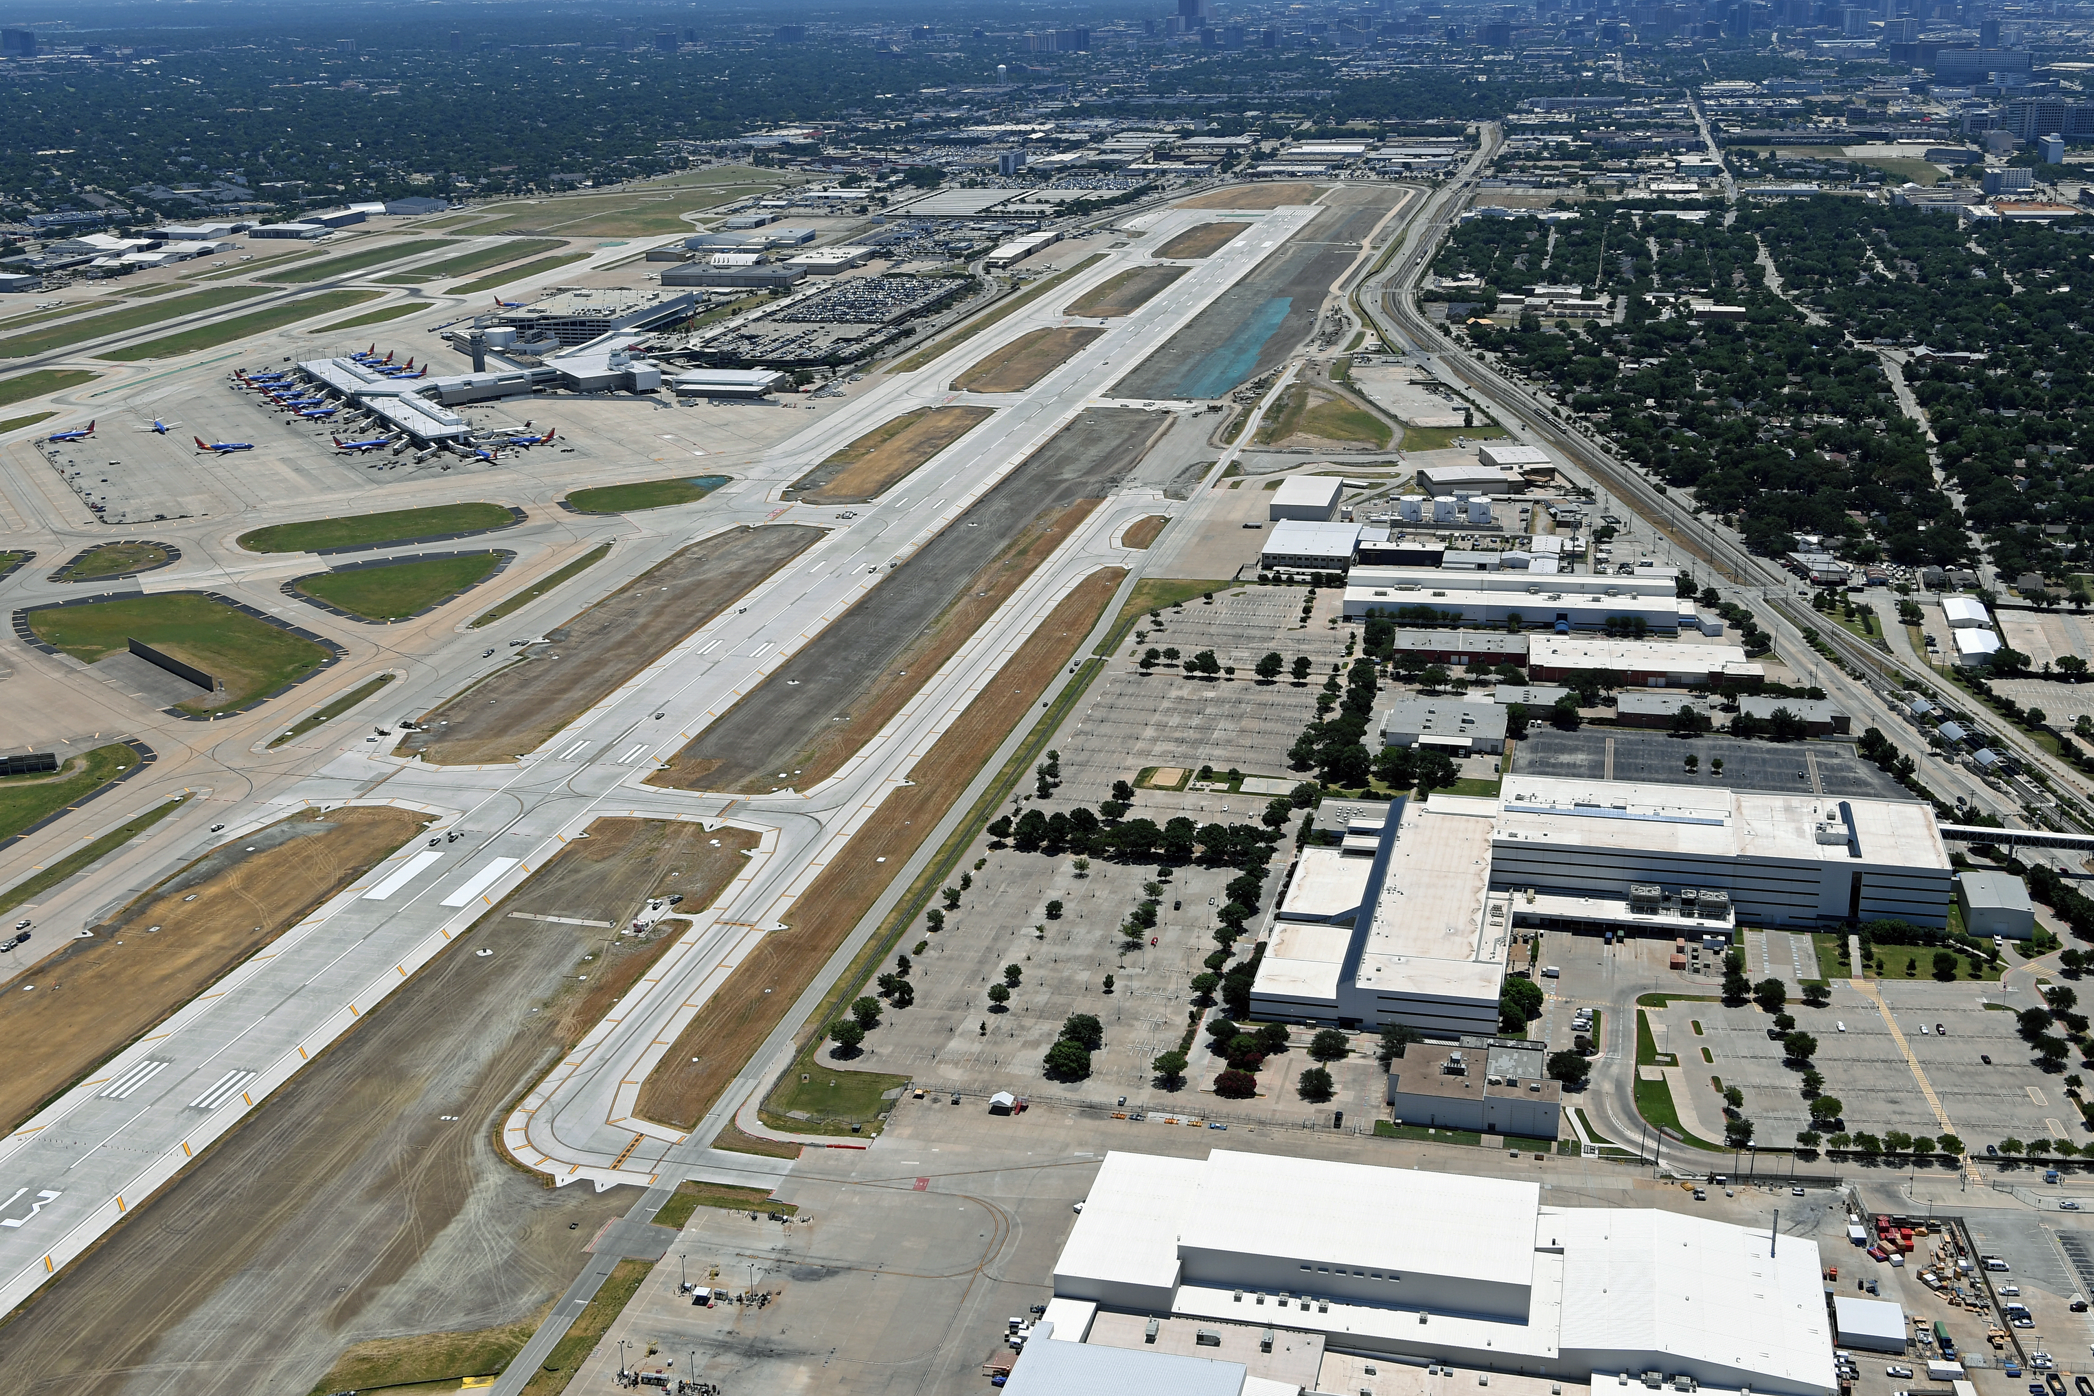
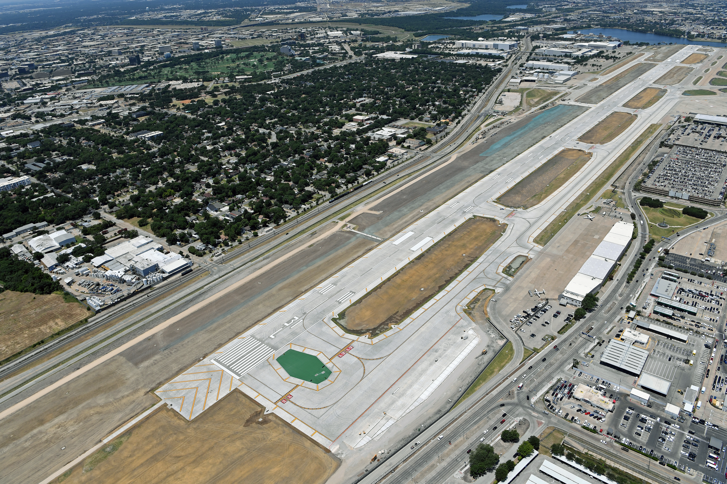
Runway 13R-31L Reconstruction
Figure 3 - New TWY T and north half of RWY 13R/31L
Figure 4 - TWY C and south half of RWY 13R/31L

Slide 18
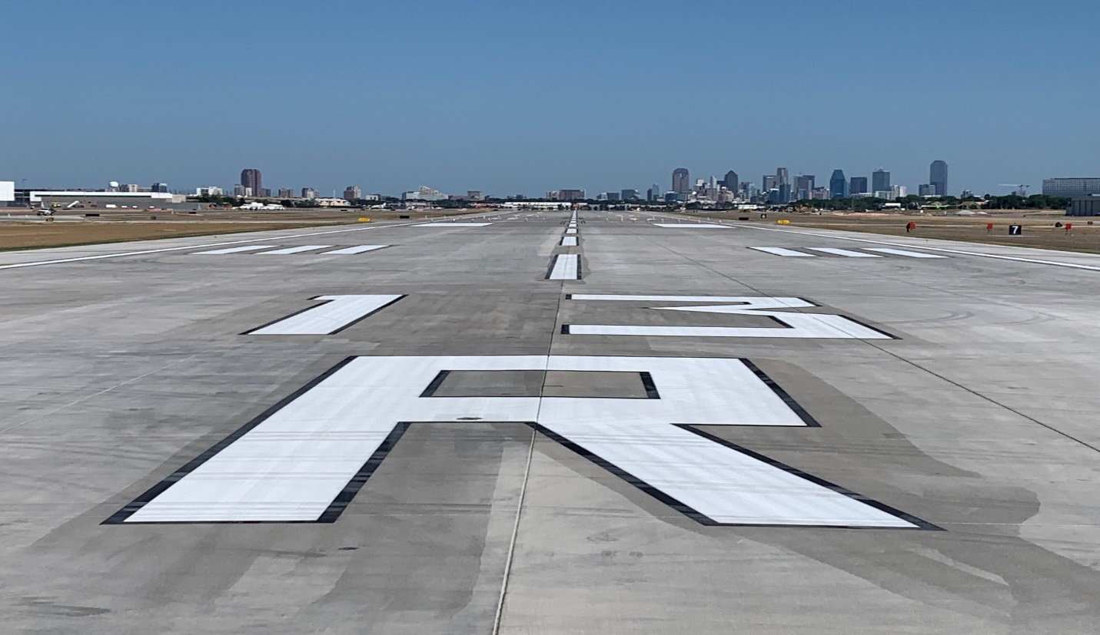
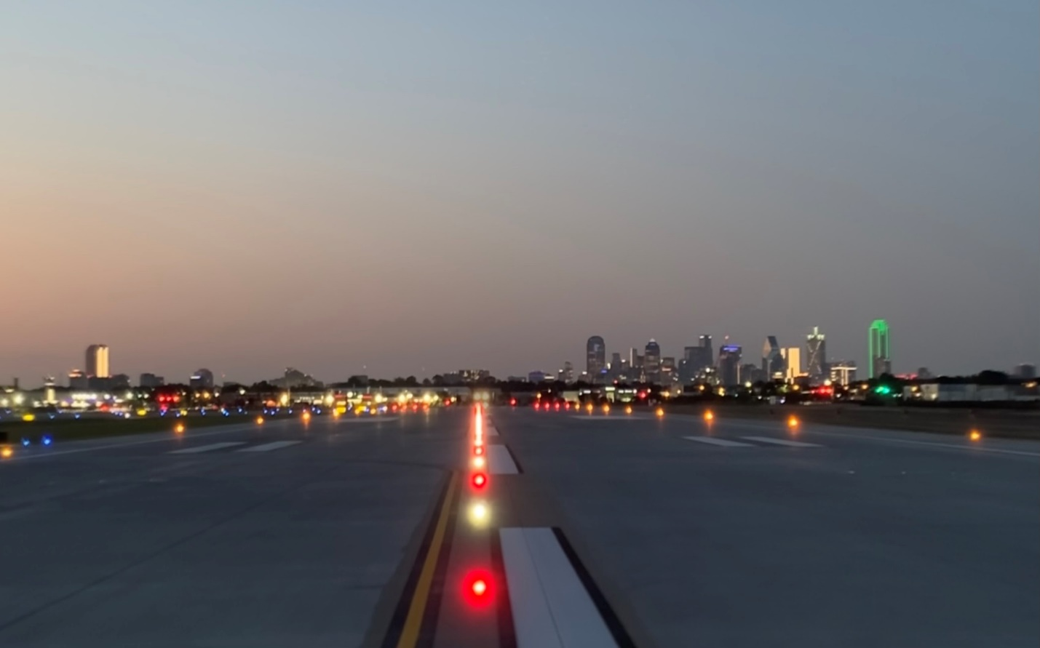
Runway 13R-31L Reconstruction
Figure 5 – RWY 13R/31L marking at North End
Figure 6 – RWY 13R/31L Nighttime lighting check on Runway

Slide 19
Airport Carbon Accreditation (ACA)

Slide 20

ACA Status and Updates
Institutionally – endorsed, global carbon management certification program for airports
Current status: Level 3 – Optimization (June 2022)
  Level 2 – Reduction (2018)
  Level 1 – Mapping (2017)
Reached carbon reduction objective to “reduce emissions by 10 percent per enplaned passenger below 2015 levels by 2025”
Looking forward:
  Achieve Level 3+ – Carbon Neutrality

Slide 21
OPEN DISCUSSION and
QUESTIONS

Slide 22
Adjourn
Next LFEAC Meeting
on
October 13, 2022, at 6 p.m.
For noise concerns visit
https://dal.noiselab.casper.aero/
For noise inquires email
AVINoise@dallascityhall.com

